Slide 1
GEHC SDT Weekly Status Report
02/16/17

Slide 2
Open Actions
Action item | Owner | Forum | Expected Closure Date | Actual Closure Date | Owner Comment | Status
CLICK certification to four of our SDT Team members | CG Team | Weekly Status | 05-Feb-2017 | 13-Feb-2017 | Deepak-CS & CM Jayesh-CS & CM Ebaad-CS & CM Farhan–CS & CM | Closed
Mobility Team or tiger team to be formed to resolve all CLICK mobile issues | Rohit | Jan’ 17 Workout | TBD |  | Tiger team is already setup now working on resolution. | In Progress
Performance issues: SDT Booking and Architecture Assessment. | Hita/Andrey/Urmila | Jan’ 17 Workout | 28-Feb-2017 |  | Initial assessment was shared. | In Progress
Ownership on Tickets/Process adherence(Agile Mechanism) | Suvarna/Sathyaraj | Jan’ 17 Workout | Ongoing |  |  | In Progress
Release management(Deployment activities for Release 1.3) | Jayesh/Tejashree | Jan’ 17 Workout | 03-Feb-2017 |  | Confirmation from Meera/Sitara on time zone difference for Indonesia region. | On Hold

Slide 3
Open Actions (contd.)
Action item | Owner | Forum | Expected Closure Date | Actual Closure Date | Owner Comment | Status
GEHC to find a problem manager from GE corporate | Chandra | Jan’ 17 Workout | TBD |  | Will identify the problem manager when we have problem in hand. | On Hold
GEHC to share nonfunctional requirements | Chandra | Jan’ 17 Workout | TBD |  | Few are identified from Rally | In Progress
GEHC to check and confirm on L1 support - on call support | Chandra | Jan’ 17 Workout | TBD |  | To confirm on L1 support | In Progress
Analysis and fixing of defects raised by Testing team and Business users. | CG Dev | Defect triage | 11-Feb-2017 | 11-Feb-2017 |  | Closed

Slide 4
Weekly Snapshot – 02/16/17
Health of the Engagement
Highlights
All Open defects are tracked to closure.
User stories created for the activities related with performance optimization
Master data load on Sand box 2 for R1.3
Deployment of R2.1.0 (Click related) testing completed on Sandbox1
Deployment of R1.3 in staging is completed and UAT is completed
CLICK R2.2 Release changes on Sandbox 1 completed.
CLICK R2.1 & R2.2 CMT file package generated and will be deployed on Stage today.
Support activities(Creating Task on SB1 for testing, CM login issue, testing release changes, FE removal changes and Follow up Duration issue)
Testing :User stories analysis for R1.4 in progress.
Started preparing draft copy of Test scripts based on the Rally User stories for R1.4
Successfully completed execution of all the 7 scripts without any script errors.
GREEN
Risk / Issues / Challenges
Help Needed
Click DB access(Prod, Stage, Sandbox) for Gopi & Preeti
Need resolution to infrastructure related queries
Need support on performance related issues on CLICK side.
Need help with Backlog grooming.

Slide 5
Focus Area Updates
Focus Areas | Owner | Status | Comments
Mobile Sync Issues | CG Team | In Progress | All reported issues related to Mobile sync are captured and analyzed. Findings was shared with business. 5 issues were fixed from click and will be a part of Patch9/10. Deployment completed and UAT in progress. Scheduled a call with Tiger and CLICK team on Friday.
SDT Booking Performance Issues | CG Team | In Progress | Identified the pain areas w.r.t performance and identified bottlenecks. Some more queries pending regarding architecture assessment with network team.
Release Management | CG Team | In Progress | Release check list was created and it is updated in our Release readiness check call.
Incident Management | CG Team | Ongoing | Streamlining incidents w.r.t CLICK support cases Problem ticket creation process finalized. Incidents reported in this week are closed.
Support and Development Process streamlining | CG Team | Ongoing | All user stories have been created and tracked through Rally. Daily SCRUM calls initiated and actions tracked to closure Ensuring all email communication to have incident ticket created. Internal defect tracker is maintained to track the QA/UAT defects and owners defined for each defect.

Slide 6
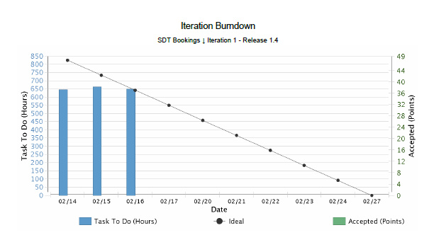

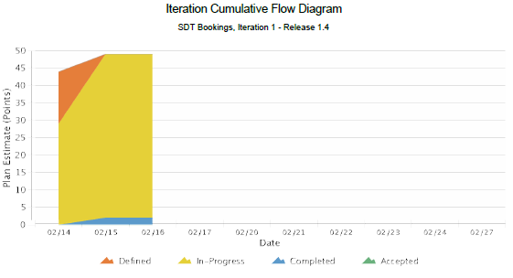
Rally Charts
SDT Development Release 1.4 Iteration 1 14th Feb to 27th Feb ‘17
Inferences
Release 1.4 Iteration 1(Defined vs. In-Progress vs. Completed)
US#97
US#98
US#100
US#108
US#87
Planned vs. Actual
Estimations done
Efforts logged
Inferences

Slide 7
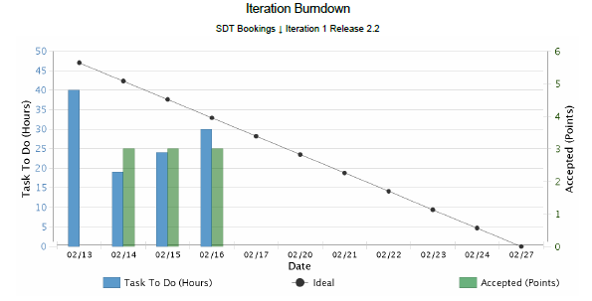
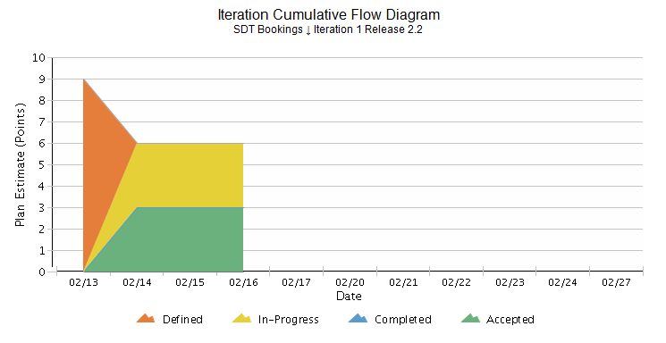
Rally Charts
SDT Click, Support and Incidents
Inferences
Release 2.2 Iteration 1(Defined vs. In-Progress vs. Completed)
Click Support
Service Now Incidents
Performance improvement analysis from Click
Planned vs. Actual
Estimations made
Adhoc requests handling
Efforts logged
Inferences

Slide 8
Incident Update
Resolved 1 incident ticket
19 Awaiting 3rd party - SDT Schedule / Mobile Issues
17 - CLICK Mobile issues
1 - Known error/issue
1 - Master Data
Inferences

Slide 9
Incident Tickets
Incident Management
Incident # | Module | Key Words | Status | Problem #
INC1370193 | SDT Mobile | Mobile sync Issue | Awaiting 3rd Party | NA
INC1418668 | SDT Schedule | Master Data | Awaiting 3rd Party | NA
INC1420698 | SDT Schedule | Scheduled - Known Error | Awaiting 3rd Party | NA
INC1435230 | SDT Mobile | Mobile sync Issue | Awaiting 3rd Party | NA
INC1435245 | SDT Mobile | Mobile sync Issue | Awaiting 3rd Party | NA
INC1435289 | SDT Mobile | Mobile sync Issue | Awaiting 3rd Party | NA
INC1435961 | SDT Mobile | Mobile sync Issue | Awaiting 3rd Party | NA
INC1447060 | SDT Mobile | Mobile sync Issue | Awaiting 3rd Party | NA
INC1447037 | SDT Mobile | Mobile sync Issue | Awaiting 3rd Party | NA
INC1447031 | SDT Mobile | Mobile sync Issue | Awaiting 3rd Party | NA
INC1446914 | SDT Mobile | Mobile sync Issue | Awaiting 3rd Party | NA
INC1447042 | SDT Mobile | Mobile sync Issue | Awaiting 3rd Party | NA
INC1447028 | SDT Mobile | Mobile sync Issue | Awaiting 3rd Party | NA
INC1454094 | SDT Mobile | Mobile sync Issue | Awaiting 3rd Party | NA
INC1463913 | SDT Mobile | Mobile sync Issue | Awaiting 3rd Party | NA
INC1464027 | SDT Booking | Click Issue | Awaiting User Info | NA
INC1477114 | SDT Booking | Mobile Sync Issue | Awaiting User Info | NA
INC1480047 | SDT Mobile | Mobile Validation Issue | Awaiting 3rd Party | NA
INC1480941 | SDT Mobile | Mobile Validation Issue | Awaiting 3rd Party | NA
INC1480772 | SDT Mobile | Mobile sync Issue | Awaiting User Info | NA
INC1486871 | SDT Mobile | Mobile sync Issue | Awaiting 3rd Party | NA
INC1491231 | SDT Mobile | Mobile sync Issue | Awaiting 3rd Party | NA
Problem Management
Problem # | Module | Keyword | Status | Incident #
PRB0045855 | SDT Booking | Google API | Open | INC1371682, INC1389372, INC1357120
PRB0045895 | SDT Booking | Email Activity | Open | INC1285226
PRB0045475 | SDT Booking | Performance - Connectivity | Known Error / Pending CA | INC1310582

Slide 10
THANK YOU

